Slide 1
Updates for Cargill 5/07/20

Slide 2
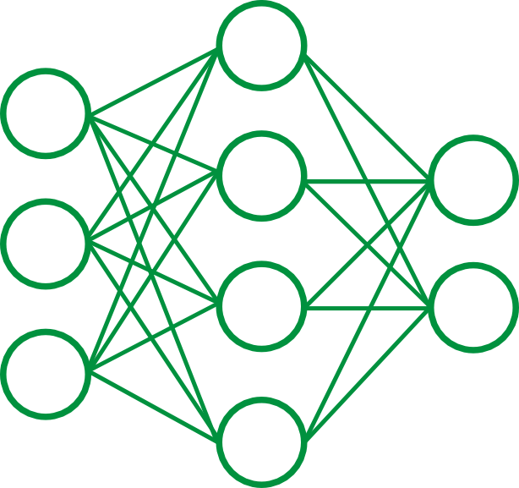
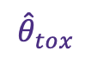
Feature Generation Pipeline
Input
Data
CCCCCOC(=O)CCC(=O)O
BrC1=C(NC(=O)C=C1)OCCOCCOC=N
C1=C(C2CO2)S(=O)(=O)C2=C(OCCO2)S1
BrC1=C2CC3(COCCO3)C(C=O)C2=CC=N1
C(=O)N1CCOC=O…
Chemical Properties
Structural Fingerprints
Toxicity
…
N1
CCCCCOC(=O)CCC(=O)O
BrC1=C(NC(=O)C=C1)OCCOCCOC=N
C1=C(C2CO2)S(=O)(=O)C2=C(OCCO2)S1
C(=O)N1CCOC=O…
1 | 0 | 0 | 1 | … | 0 | 1 | 0
0 | 0 | 0 | 0 | … | 0 | 0 | 1
0 | 1 | 0 | 0 | … | 0 | 1 | 0
1 | 1 | 0 | 0 | … | 0 | 0 | 0
=O
$${\hat{θ}}_{tox}$$
C
*nn trained on tox21 dataset

Slide 3
Feature Generation Pipeline
Input
Data
CCCCCOC(=O)CCC(=O)O
BrC1=C(NC(=O)C=C1)OCCOCCOC=N
C1=C(C2CO2)S(=O)(=O)C2=C(OCCO2)S1
BrC1=C2CC3(COCCO3)C(C=O)C2=CC=N1
C(=O)N1CCOC=O…
Chemical Properties
Structural Fingerprints
Toxicity
…
N1
CCCCCOC(=O)CCC(=O)O
BrC1=C(NC(=O)C=C1)OCCOCCOC=N
C1=C(C2CO2)S(=O)(=O)C2=C(OCCO2)S1
C(=O)N1CCOC=O…
1 | 0 | 0 | 1 | … | 0 | 1 | 0
0 | 0 | 0 | 0 | … | 0 | 0 | 1
0 | 1 | 0 | 0 | … | 0 | 1 | 0
1 | 1 | 0 | 0 | … | 0 | 0 | 0
=O
$${\hat{θ}}_{tox}$$
C
{
*nn trained on tox21 dataset
Pipeline can be used to generate features for any given set of molecules
GDB-17
Plasticizers
PubChem
Organics

Slide 4
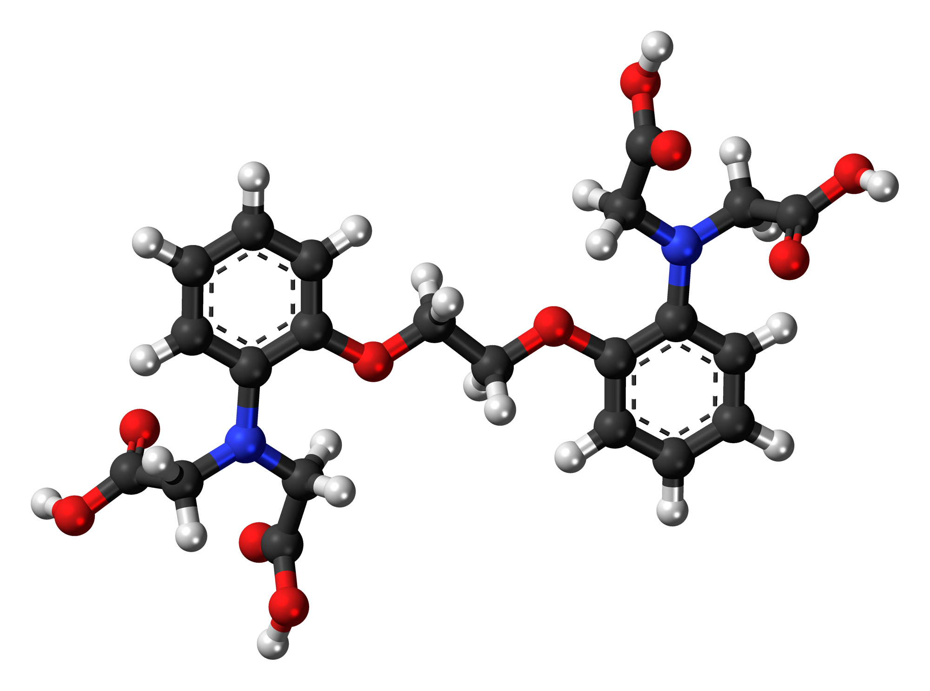
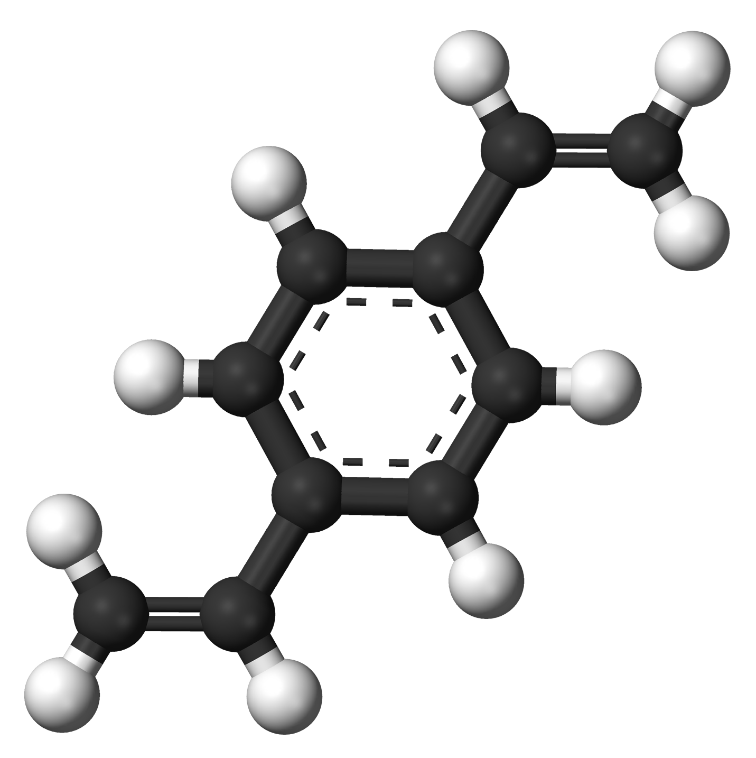

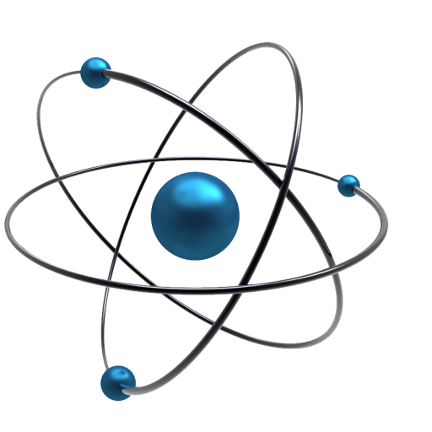
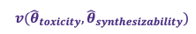
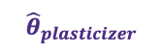
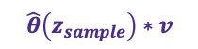
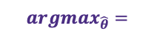
Proposed Learning Pipeline
Molecular Generation
$${argmax}_{\hat{θ}}=$$
Decoder
Reconstructed
SMILES
Encoder
SMILES
Feature Gen
Property
Predictor
$$v({\hat{θ}}_{toxicity},{\hat{θ}}_{synthesizability})$$
$${\hat{θ}}_{plasticizer}$$
$$\hat{θ}\left(z_{sample}\right)∗v$$

Slide 5
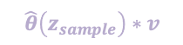
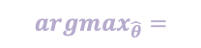

Proposed Learning Pipeline
Molecular Generation
$${argmax}_{\hat{θ}}=$$
Decoder
Reconstructed
SMILES
Encoder
SMILES
Property
Predictor
$$v({\hat{θ}}_{toxicity},{\hat{θ}}_{synthesizability})$$
$${\hat{θ}}_{plasticizer}$$
$$\hat{θ}\left(z_{sample}\right)∗v$$

Slide 6

Proposed Learning Pipeline
Molecular Generation
$${argmax}_{\hat{θ}}=$$
Decoder
Reconstructed
SMILES
Encoder
SMILES
Property
Predictor
$$v({\hat{θ}}_{toxicity},{\hat{θ}}_{synthesizability})$$
$${\hat{θ}}_{plasticizer}$$
$$\hat{θ}\left(z_{sample}\right)∗v$$

Slide 7
Proposed Learning Pipeline
Molecular Generation
$${argmax}_{\hat{θ}}=$$
Decoder
Reconstructed
SMILES
Encoder
SMILES
Property
Predictor
$$v({\hat{θ}}_{toxicity},{\hat{θ}}_{synthesizability})$$
$${\hat{θ}}_{plasticizer}$$
$$\hat{θ}\left(z_{sample}\right)∗v$$

Slide 8
Proposed Learning Pipeline
Molecular Generation
$${argmax}_{\hat{θ}}=$$
Decoder
Reconstructed
SMILES
Encoder
SMILES
Property
Predictor
$$v({\hat{θ}}_{toxicity},{\hat{θ}}_{synthesizability})$$
$${\hat{θ}}_{plasticizer}$$
$$\hat{θ}\left(z_{sample}\right)∗v$$

Slide 9
Proposed Learning Pipeline
Molecular Generation
Use Cases 1 and 2
Relate chemical properties/structure to plasticizing likelihood
$${argmax}_{\hat{θ}}=$$
Decoder
Reconstructed
SMILES
Encoder
SMILES
Property
Predictor
$$v({\hat{θ}}_{toxicity},{\hat{θ}}_{synthesizability})$$
$${\hat{θ}}_{plasticizer}$$
$$\hat{θ}\left(z_{sample}\right)∗v$$

Slide 10
Plasticizer Likelihood Function
One-Class Classification
SVM
Robust Covariance
Kernel Density Estimate
Outlier Detection
Given a distribution of data with single label, can we predict if unseen data is an outlier?
Plasticizers -> given distribution
Random Test Molecules -> outlier or member of plasticizers class?

Slide 11
Plasticizer Likelihood Function
One-Class Classification
SVM
Robust Covariance
Kernel Density Estimate
Outlier Detection
Test Accuracy
Does our model accurately predict new plasticizers?
Hit Percent
What percentage of random molecules are identified as potential plasticizers?

Slide 12
Plasticizer Likelihood Function
One-Class Classification
SVM
Robust Covariance
Kernel Density Estimate
Kernel Density Estimate
Performs as well as RC in two dimensions
Easy to switch between 1D/2D and regression/classification

Slide 13
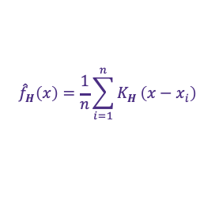
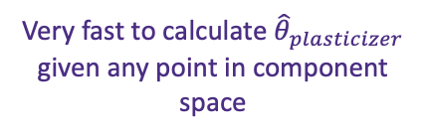

Plasticizer Likelihood Function
One-Class Classification
SVM
Robust Covariance
Kernel Density Estimate
1. Construct PCA Model
2. Calculate Multivariate KDE
$${\hat{f}}_{H}\left(x\right)=\frac{1}{n}\sum_{i=1}^{n}{K_{H}}\left(x−x_{i}\right)$$
$${\hat{f}}_{H}\left(x_{GDB}\right)={\hat{θ}}_{plasticizer}(x_{GDB})$$
Select small subset of data to build model (important to get good separation in this step!)
Very fast to calculate ${\hat{θ}}_{plasticizer}$ given any point in component space

Slide 14
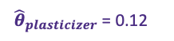
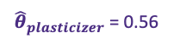

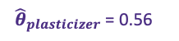
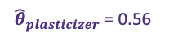
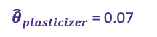
Testing ${\hat{θ}}_{plasticizer}$ on GDB-17
Top Candidate Molecules Sampled from GDB-17
${\hat{θ}}_{plasticizer}$ = 0.56
${\hat{θ}}_{plasticizer}$ = 0.56
${\hat{θ}}_{plasticizer}$ = 0.56
${\hat{θ}}_{plasticizer}$ = 0.12
${\hat{θ}}_{plasticizer}$ = 0.07
1st dimension captures enough variance

Slide 15
Testing ${\hat{θ}}_{plasticizer}$ on GDB-17
Top Candidate Molecules Sampled from GDB-17
${\hat{θ}}_{plasticizer}$ = 0.56
${\hat{θ}}_{plasticizer}$ = 0.56
${\hat{θ}}_{plasticizer}$ = 0.56
${\hat{θ}}_{plasticizer}$ = 0.12
${\hat{θ}}_{plasticizer}$ = 0.07
1st dimension captures enough variance
(GDB is not known for it’s realism)

Slide 16
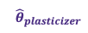
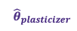

Testing ${\hat{θ}}_{plasticizer}$ on PubChem
Fingerprints
Descriptors
Both
~66,000 organic compounds
More realistic starting set
Harder to get good split through PCA -> may need to explore labeled regression
${\hat{θ}}_{plasticizer}$
${\hat{θ}}_{plasticizer}$
0.889
0.216
0.888
0.214
TBD
0.888
0.214
0.888
0.214
0.888
0.213

Slide 17
Plasticizer Similarity with DEHP

Slide 18
Next Steps
Re-evaluate tradeoff between using all plasticizer data vs. removing outliers/non-uniformity
Make final decision on feature selection and solidify plasticizer likelihood
Communicating w/ACD on command line software
Feature selection (e.g. polarizability, molar volume)
Toxicity
Build VAE

